Slide 1
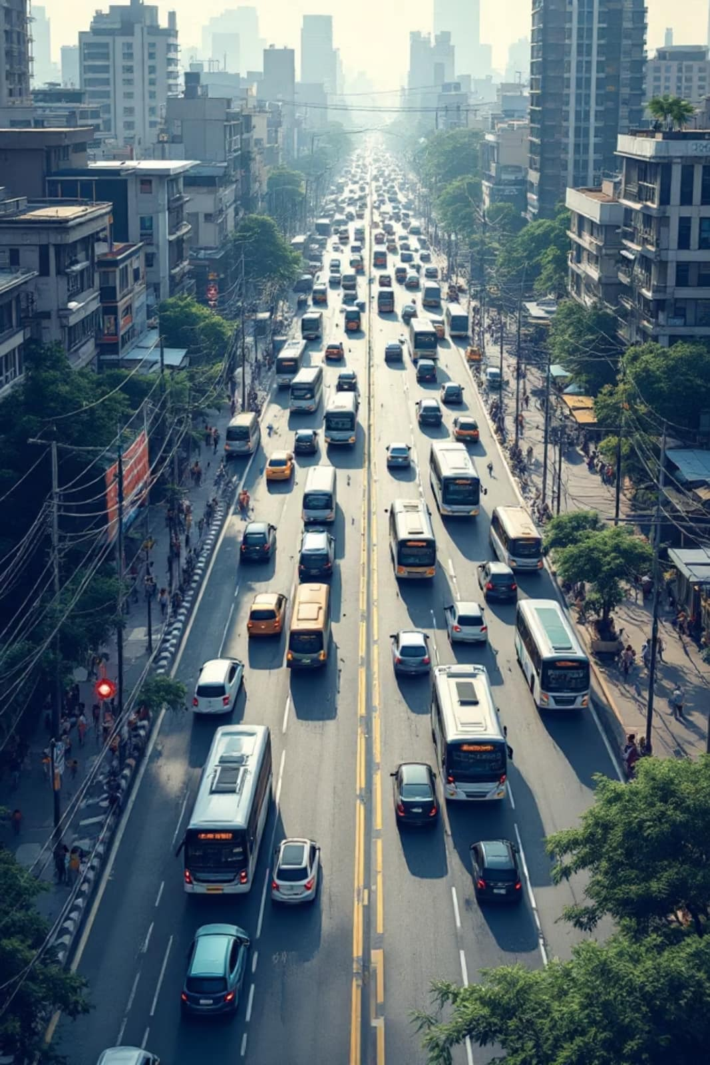
Exploratory Data Analysis on Student Daily Commute
Investigating patterns, costs, and bottlenecks in student travel across Pune.
Symbiosis Institute of Technology, Pune
Sem II (2025-26), EDA Project
Contributors: Tannishtha Gupta (25070123049), Tanmay Agarwal (25070123158)

Slide 2
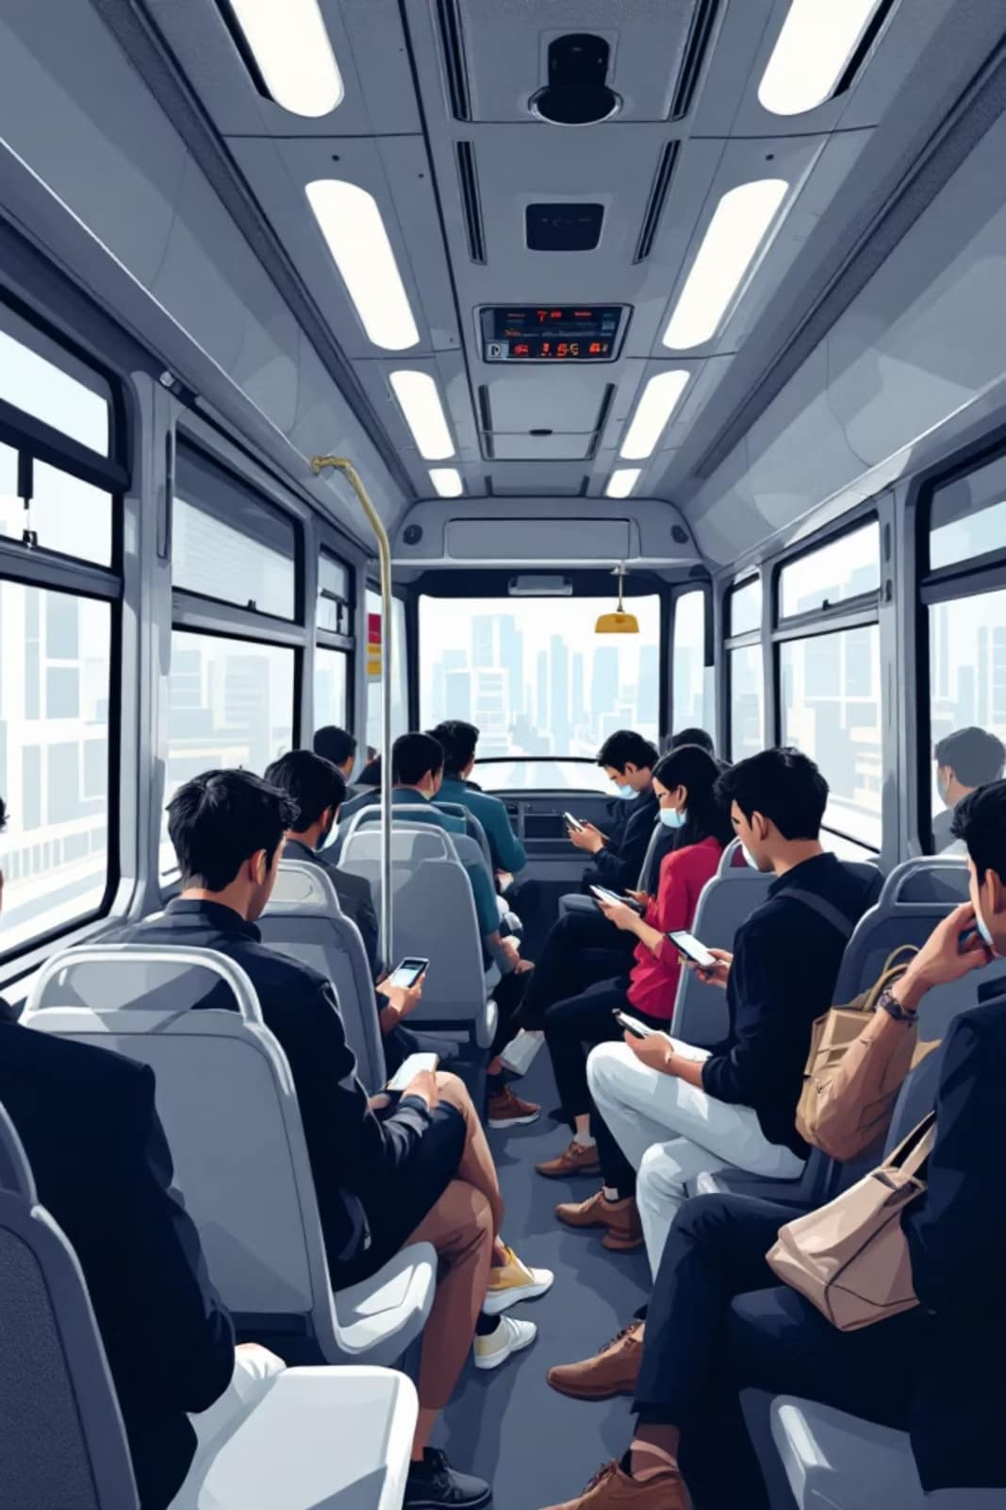

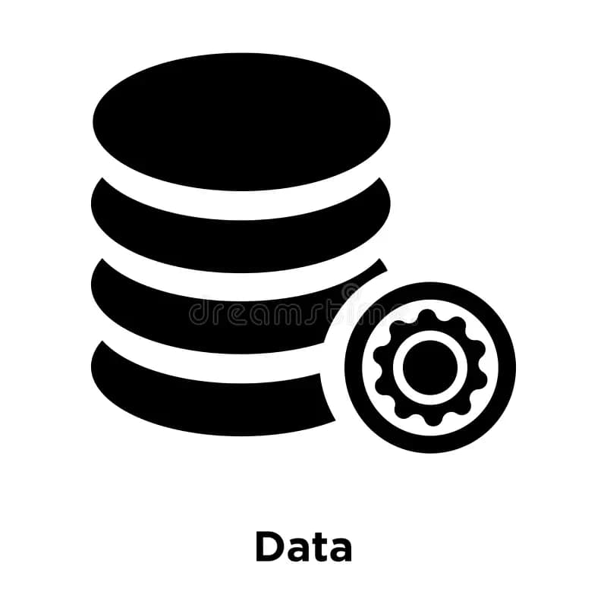
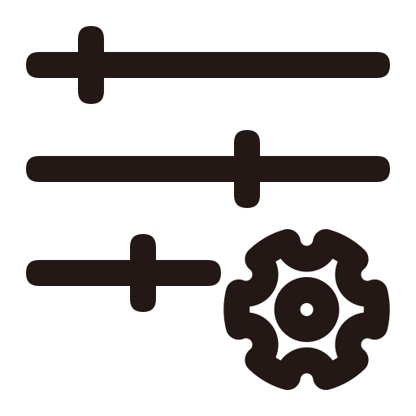
Project Overview & Objectives
How do students navigate Pune — and where does the system fail them? This project digs into real commute data to surface actionable insights.
The Goal
The Data
Identify the most efficient transport modes and major pain points in student commutes across Pune.
724 real survey responses collected via Google Forms — capturing authentic, ground-level travel behavior.
Key Parameters
Travel time, one-way cost, starting points, destinations, and satisfaction levels (1–5 scale).

Slide 3
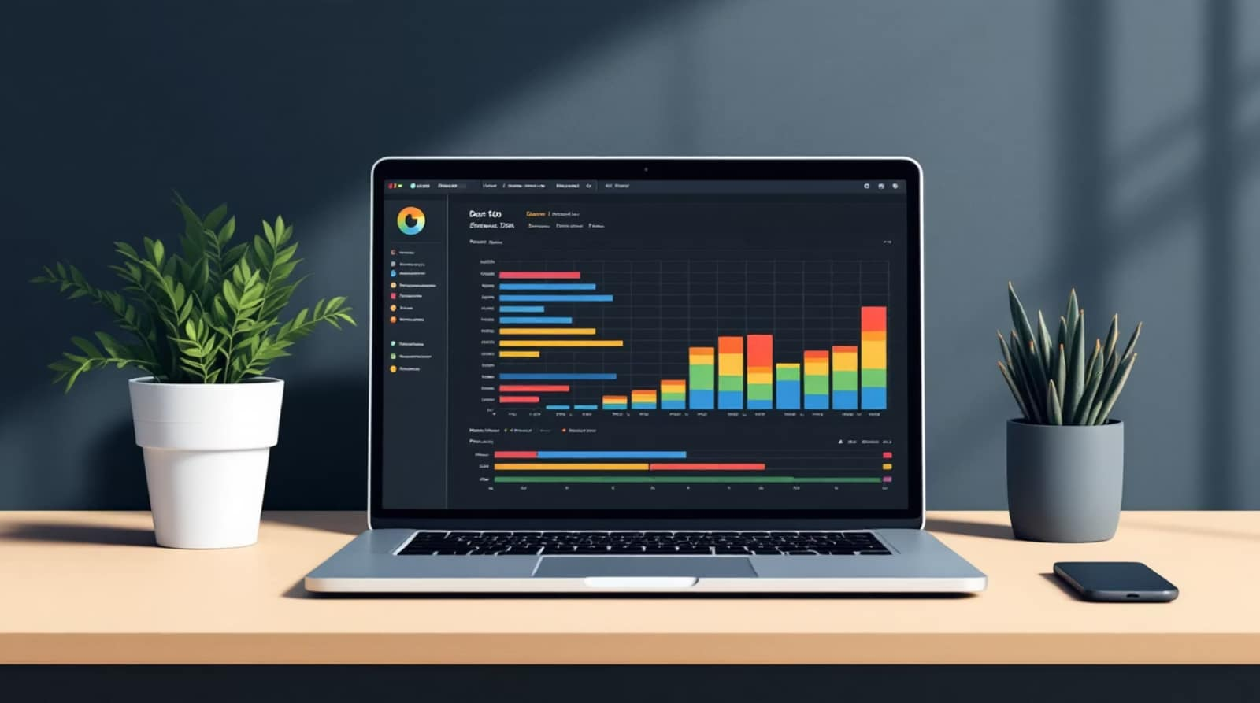
Dataset Description
Structure
724 rows × 10 columns — each row represents one student's commute profile.
Key Columns
Primary_Mode — transport type used
Travel_Time_min — one-way duration
One_Way_Cost_INR — daily expense
Delay_Points — reported bottlenecks
Satisfaction — self-rated score (1–5)
Geographic Scope
Origins: Kothrud, Baner, SIT Lavale. Destinations: Hinjewadi, Pune Station, and more.

Slide 4
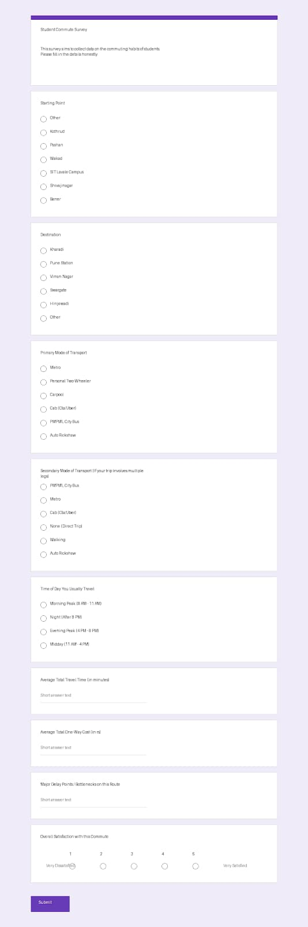
Our Google Forms Layout and Snippets

Slide 5
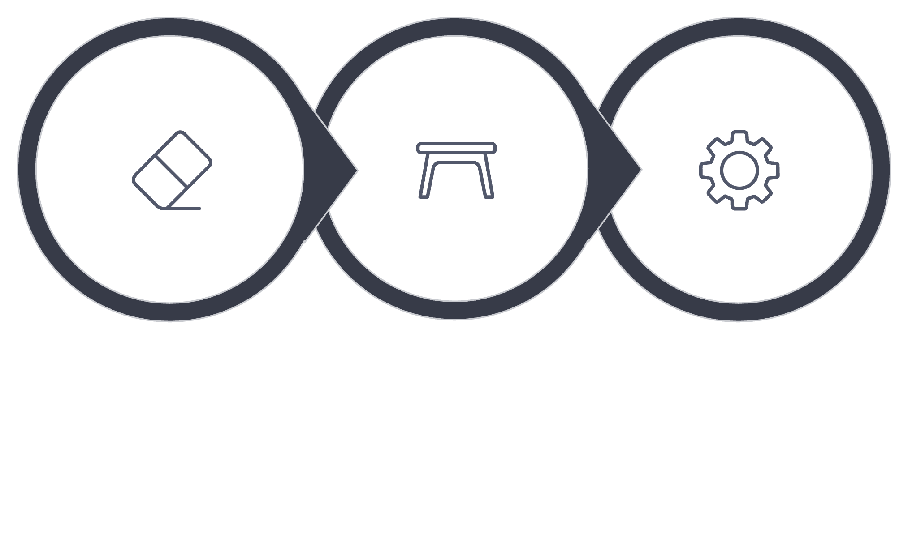
Data Cleaning & Preprocessing
TECHNICAL SLIDE
Handle Missing
Inspect Types
Feature Engineer
Cleaning the raw survey data ensured analytical integrity — transforming 724 messy responses into a structured, analysis-ready dataset.

Slide 6
Descriptive Statistics
A snapshot of the average student commute in Pune — and the spread that tells the real story.
57 min
₹127
Avg. Travel Time
Avg. One-Way Cost
SD ≈ 22 min — wide variation across students and modes.
SD ≈ ₹89 — cost varies dramatically by mode choice.
724
10
Survey Responses
Dataset Columns
Collected via Google Forms — real students, real commutes.
Covering time, cost, mode, location, delay, and satisfaction.

Slide 7
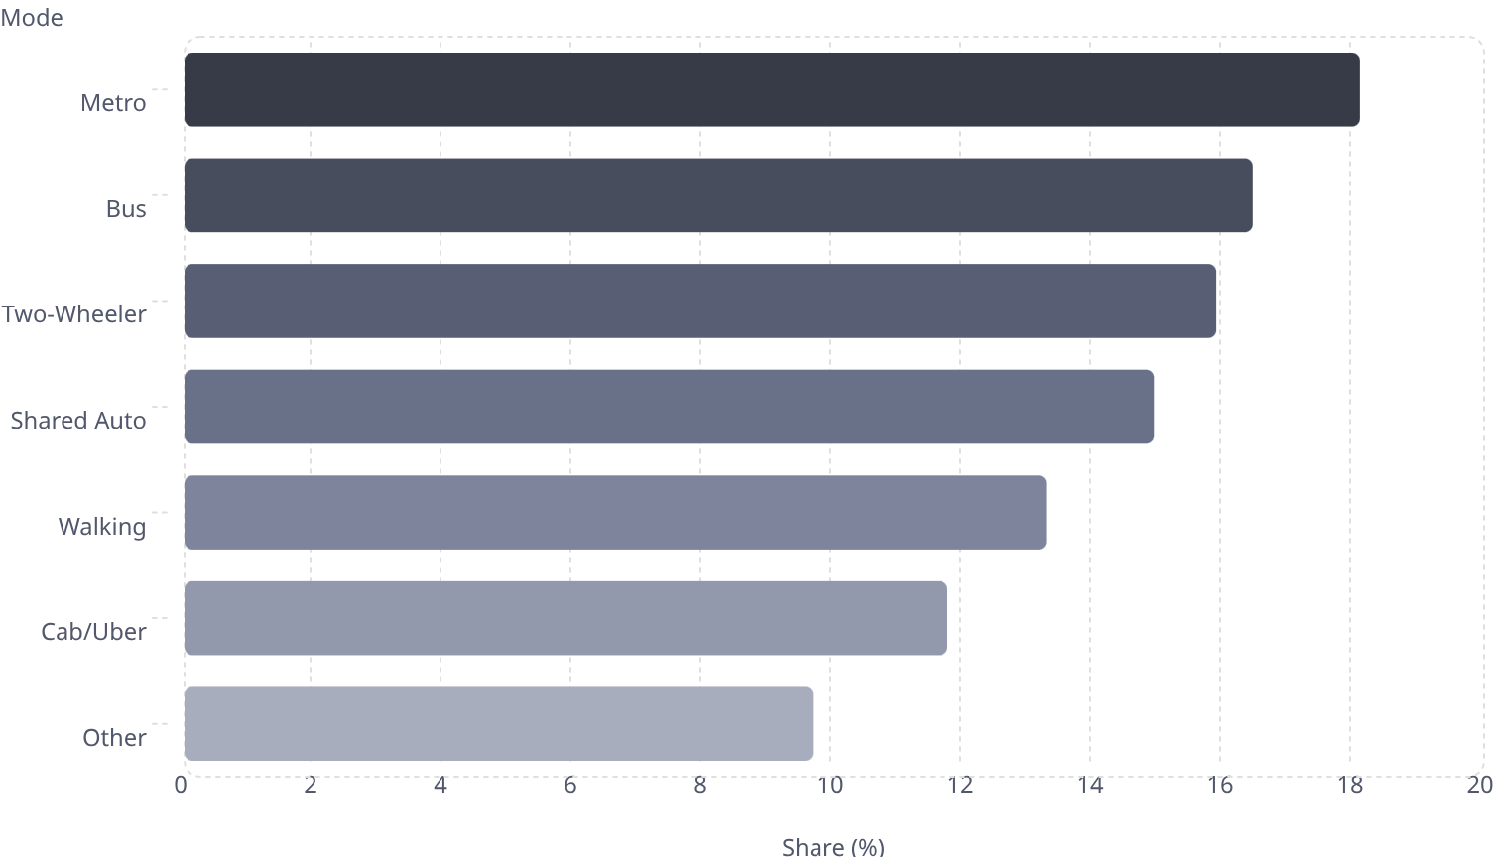

Key Findings — Mode of Transport
Metro Leads the Pack
18.1
Metro is the most popular mode at 18.09% — and also the most affordable, averaging just ~₹23 per trip.
16.4
15.9
The Expensive Alternative
14.9
13.3
Cab/Uber users pay a steep premium — averaging ~₹298 one-way, over 12× the Metro cost for similar distances.
11.7
9.67
Metro offers the best value-for-money proposition for Pune students by a significant margin.

Slide 8
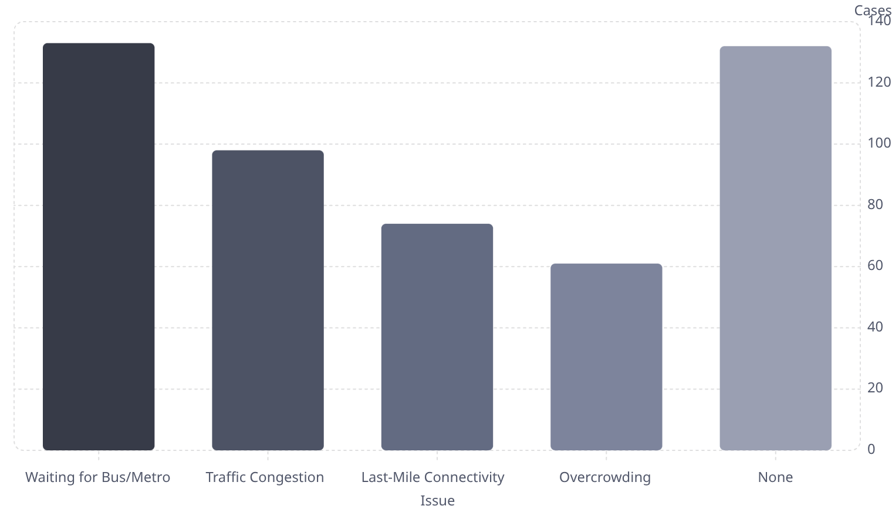

Bottlenecks & Satisfaction
Top Delay Points
The #1 Pain Point
"Waiting for Bus/Metro" was reported in 133 cases — the single largest bottleneck in the Pune student commute experience.
133
132
Satisfaction vs. Travel Time
98
Longer commutes don't automatically mean lower satisfaction — students on Metro (fast, cheap) rate satisfaction higher despite shared spaces. The relationship is mode-dependent, not purely time-dependent.
74
61
Frequency of public transport matters more than speed alone for satisfaction outcomes.

Slide 9
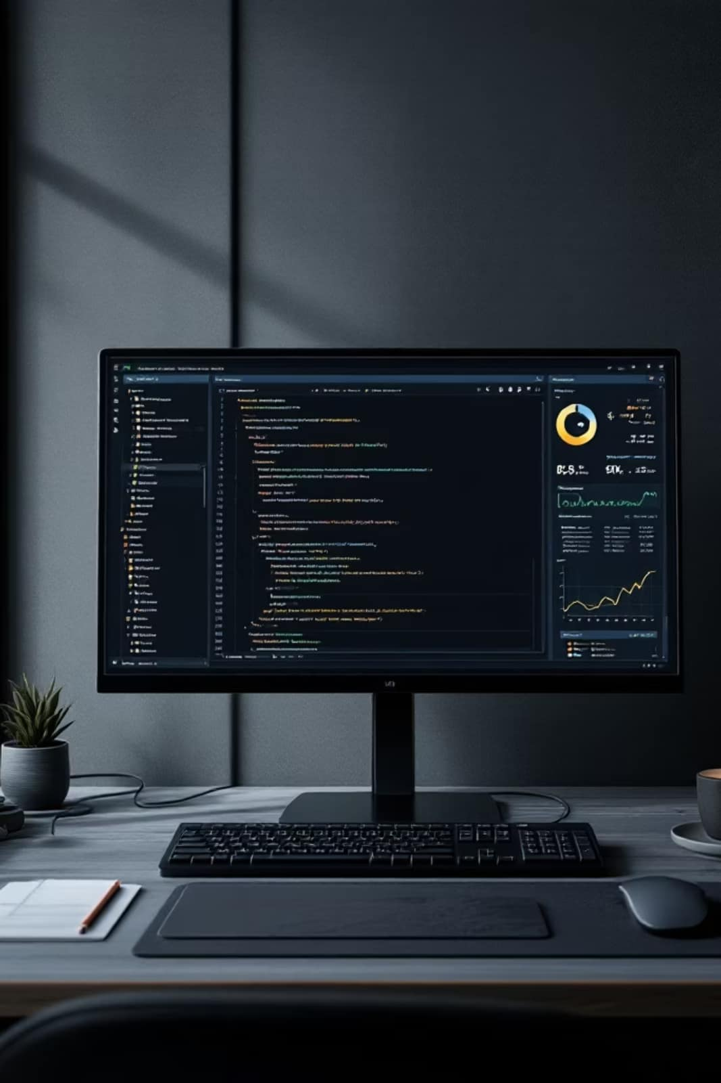
Advanced Analysis — Crosstabs & GroupBy
Travel Time vs. Mode
Metro is the fastest at ~39 min average, outperforming Cab (~51 min) and Bus (~63 min) — reflecting Pune's dedicated metro corridors.
Starting Point vs. Mode
Students from Kothrud and Baner show higher reliance on two-wheelers and autos, while those near metro stations (e.g., Hinjewadi corridor) lean strongly on public transit.
Commute Category Distribution
The engineered Commute_Category column revealed that Medium commutes (30–75 min) dominate, covering the majority of surveyed students.

Slide 10
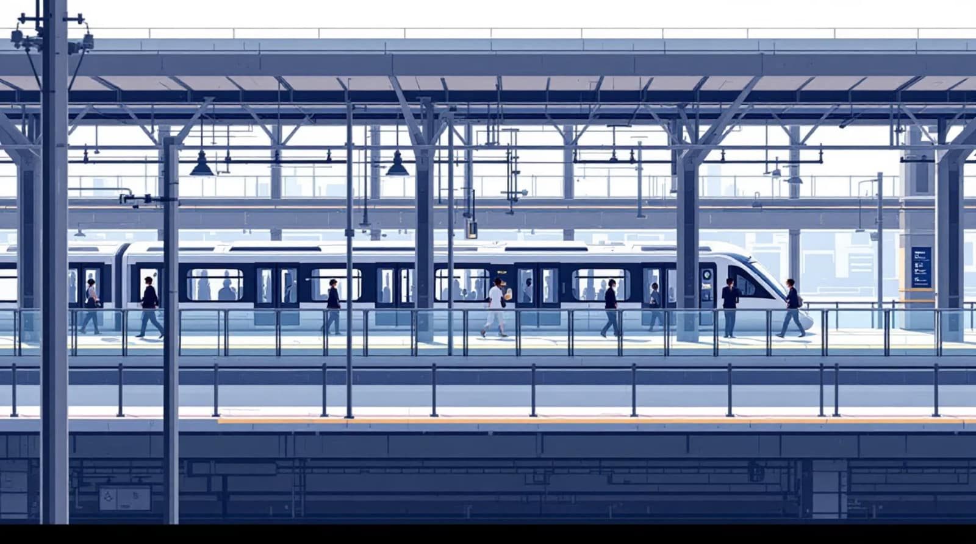

Conclusion & Recommendations
Key Takeaway
Most students spend nearly an hour commuting daily. Metro emerges as the clear "Value for Money" option — fastest, cheapest, and most used.
Recommendations
Increase public transport frequency to directly address the top bottleneck: waiting time.
Improve last-mile connectivity from metro stations to residential zones in Kothrud and Baner.
Expand metro route coverage to reduce two-wheeler dependency in outer areas.

Slide 11



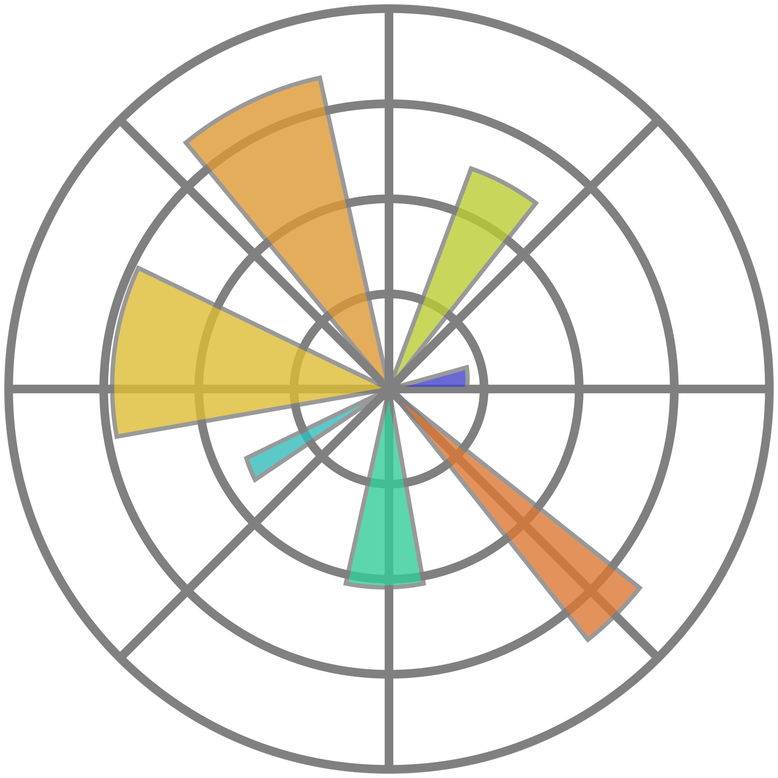

Tech Stack & Acknowledgments
Tools Used
Acknowledgments
Python
A heartfelt thank you to the 724 student respondents whose honest answers made this analysis possible.
Core language for all data processing and analysis.
Special thanks to our faculty mentor, Mrs. Snehal Bhosale, for guidance and support throughout the project.
Pandas & NumPy
Project Repository
Data wrangling, cleaning, groupby, and crosstab operations.
github.com/tanishthagupta-wq/EDA-MiniProject-A3_Group1
https://github.com/theTanmayAgarwal/EDA-MiniProject-A3_Group1
Matplotlib & Seaborn
All visualizations — bar charts, heatmaps, and distributions.
EnTC A-3, Group 1 — Symbiosis Institute of Technology, Pune
~ Tannishtha & Tanmay

